Slide 1
Introduction to the business world of Life Sciences

Slide 2
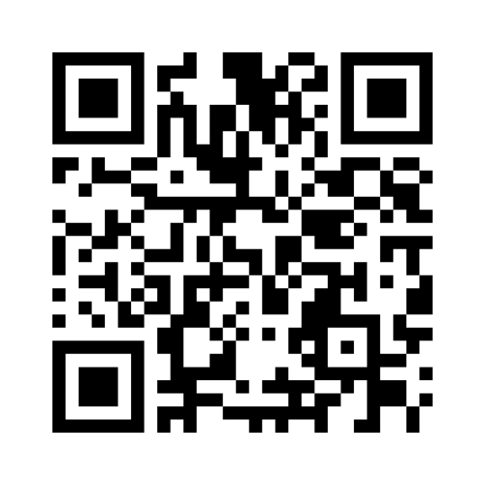
www.menti.com
Code: 3102 0225

Slide 3
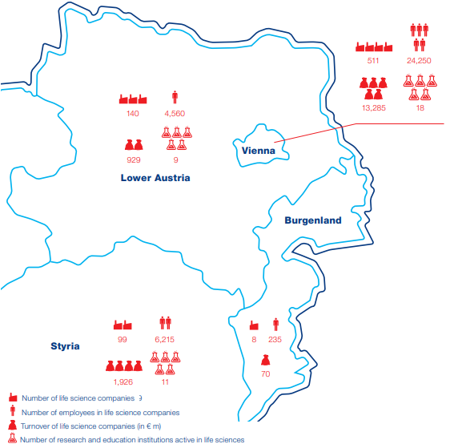
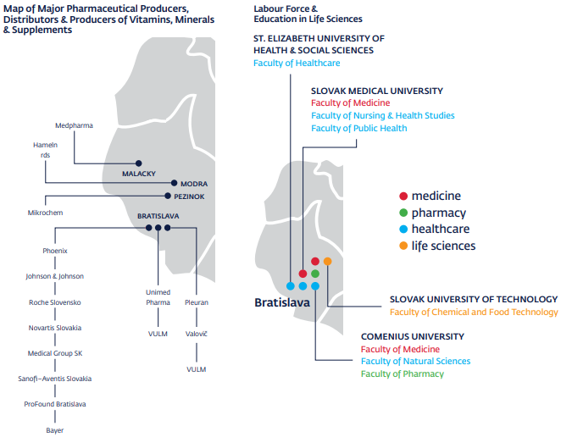
Map of the Life science sector – Vienna/Bratislava region

Slide 4
Notable innovators in Vienna:
Focus on infectious diseases, specializing in prophylactic vaccines.
Immunotherapies for treating infectious diseases and cancer.
Acute respiratory distress syndrome & immuno-oncology.
Treatments for bacterial infections based on viruses called phages.
The company has produced a new class of antifungals.
Development of antivirals targeting the rhinovirus.
Focus on making synthetic DNA for use in genetic engineering and genome building.
For more information please visit www.lifescienceaustria.at, www.lisavienna.at or www.viennabiocenter.org

Slide 5
Notable innovators in Bratislava:
Invention of a non–invasive Down syndrom diagnosis for pregnant women.
Development of an extremely precise cancer diagnosing technology & LAMP COVID-19 diagnostic tests.
Development of glycan-based, accurate and non-invasive tests for cancer diagnostics
Development of tau-based treatments that halt Alzheimer’s disease and relieve symptoms
Software for interpretation, management and processing of mass spectral and chromatographic data in the area of small molecules
For more information please visit www.slovakbiotech.com, slovacrin.sk or www.sario.sk

Slide 6
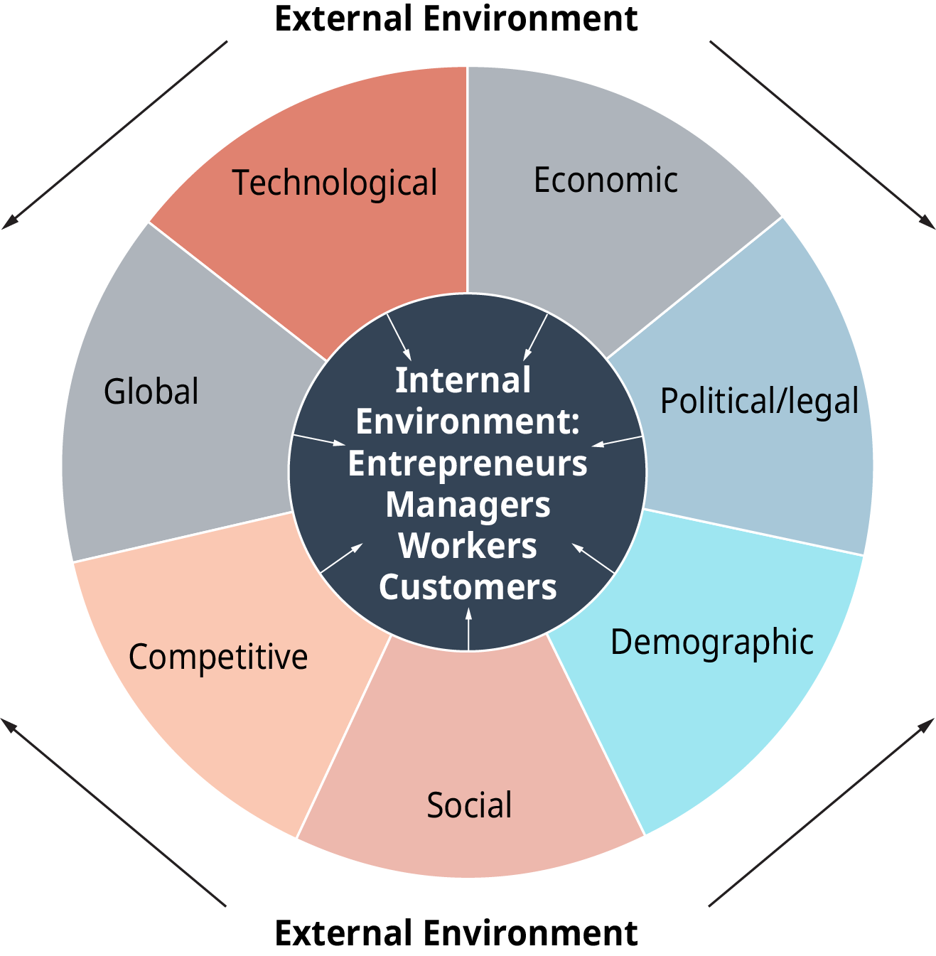
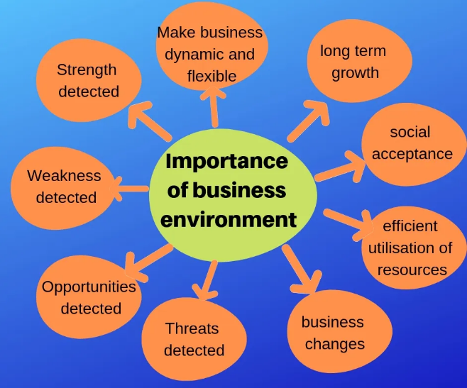
Components and importance of the business environment

Slide 7
Bioentrepreneurship vs Entrepreneurship
An entrepreneurial business based on the Biotechnology is known as Bioentrepreneurship. Biotech-based business is usually started by a researcher so that’s why a Bioentrepreneur has more knowledge of its product than any other entrepreneur.

Slide 8
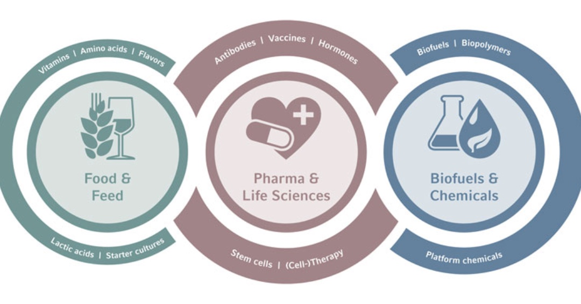
Bioentrepreneurship vs Entrepreneurship
Motivation:
Potential to Heal, Feed, and Fuel:
Helping Save and Extend Lives
Helping to Feed the World
Better Ways to Protect Environment
Second Largest Economy:
Worldwide production of biobased products – including biofuels, renewable chemicals, and biobased polymers – is projected to grow from approximately $203.3 billion in 2015 to $400 billion by 2020 and $487 billion by 2024.

Slide 9
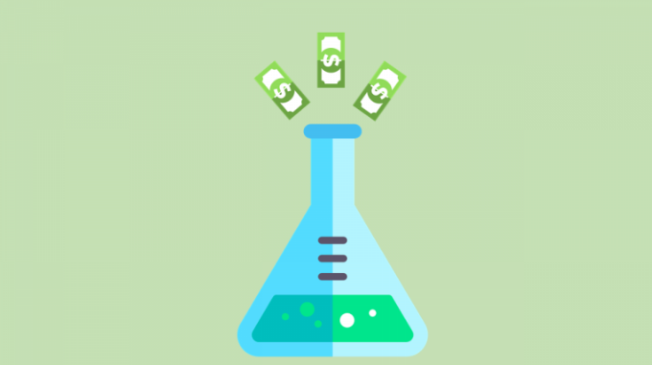
Bioentrepreneurship vs Entrepreneurship
Characteristics:
Bioentrepreneurship Versus Entrepreneurship:
Incubation requires more time
Requires more capital
Strict national and international laws and regulations
Essential Bioentrepreneurial Characteristics:
Awareness of Known-Unknowns and Unknown-Unknowns as well
Understand the Language of Business and Science
Leadership Wisdom
Resiliency
Core Values
Creativity
Notes:
Re: strict regulations to ensure research ethics
Known-Unknowns in which they know their limitations and seeks the help of experts. A bioentrepreneur is usually an expert in one field only, either its biology, chemistry or biotechnology. When ever there are some issues related to finance, accounting, compliance, production, transportation or marketing. He will hire some expert to resolve the problem.
Unknown-Unknowns - this is when you do not possess knowledge about an area critical to the company, and you do not recognize your limitations, yet you proceed anyway. In other words, these are the things you do not know, that you do not know.
Bioentrepreneur needs to understand the languages of Business and Science both. Usually, they are equipped with technical knowledge about their product or service but no interest in understanding and learning marketing, finance and legal compliance. In such condition, they fail to impress the investor. A good product but no with no market is useless for an investor. A scientist must be able to make investor understand the use of the product in common words.
Leadership is about motivating people to help you achieve your goals. Leadership depends on several aspects including the cause, followers, and goals. A leader needs to understand the factors that motivate the people. Usually, these factors include the needs and desires of the people. Often learning to increase in wisdom has to do with closing our mouths more often and listening carefully in order to understand the communicated thoughts and ideas of others.
Failure is the most common thing that happens in an entrepreneurial setup. Every entrepreneur has to be resilient towards failures and hurdles. A strategic approach is very necessary to achieve the goals of the organization. A resilient bioentrepreneur always several alternates and chooses the best in a certain situation by research, experimentation, and experience. Resilience is the virtue that enables people to move through hardship and become better. No one escapes pain, fear, and suffering. Yet from pain can come wisdom, from fear can come courage, from suffering can come strength — if we have the virtue of resilience.
When embraced properly, core values become part of your day-to-day activities within your company’s walls and beyond. They are a compass for performance and the stories you tell when asked about your business. Make them matter.
New ideas and concepts breed better companies. it is essential to the success of every biotechnology entrepreneur. Creative and imaginative entrepreneurs can accomplish great things when coupled with having leadership wisdom.
https://techooid.com/bioentrepreneurship

Slide 10
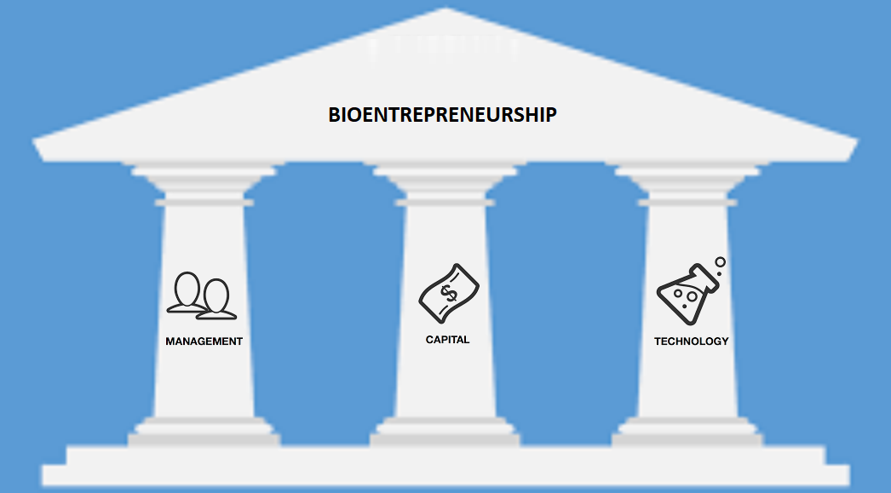
Bioentrepreneurship vs Entrepreneurship
Creating a biotechnology company that lasts depends on the ability to balance management, capital, and technology - the three pillars of bioentrepreneurship:

Slide 11
Bioentrepreneurship vs Entrepreneurship
Capital:
private investments
venture capital
corporate partnership / joint ventures
public-private partnership
Management:
ability to direct a research and development organization and the ability to communicate the company's promise to the financial community
manufacturing, commercialization and collaboration capabilities
resource allocation capabilities
Technology:
licensing technology from academia
excessive R&D
well–defined and well–articulated product focus
Notes:
Management:
A chief executive officer and management team equipped to run a biotechnology company from startup through commercialization are one of the scarcest resources in the industry. Consequently, management is often the weakest pillar in most biotechnology companies. This is largely because the repertoire of managerial skills required to navigate the company successfully from startup through full integration is so wide ranging.
Since few biotechnology companies in the early stages of development can internally develop a full range of operating capabilities, the precise nature of these relationships, and the timing of their implementation, must be carefully managed for their impact on the company.
Capital:
privately financed – pros: not dealing with investors, keeping all the profits / cons: usually too high to bear
venture capital – pros: keeping control of the company / cons: sharing profits, dilution of shareholder interest
corporate partnership – pros: financed by corporations, development and regulatory expertise - a significant reduction in risk for the young biotechnology company / cons: only a modest royalty on the product's sales, IP rights...
public-private partnership – pros: financed mostly through grants / cons: low ROI, IP rights
Technology:
Product focus - whether directed toward a specific technology or toward a disease area, the company needs a clear vision of its basis for future revenues. What is unique to biotechnology in this regard is that a single product or two may be sufficient to create the foundation for a large, profitable company.
pharmaceuticals,
biotechnology-based food and medicines,
medical devices,
biomedical technologies,
nutraceuticals,
cosmeceuticals,
food processing
etc...

Slide 12
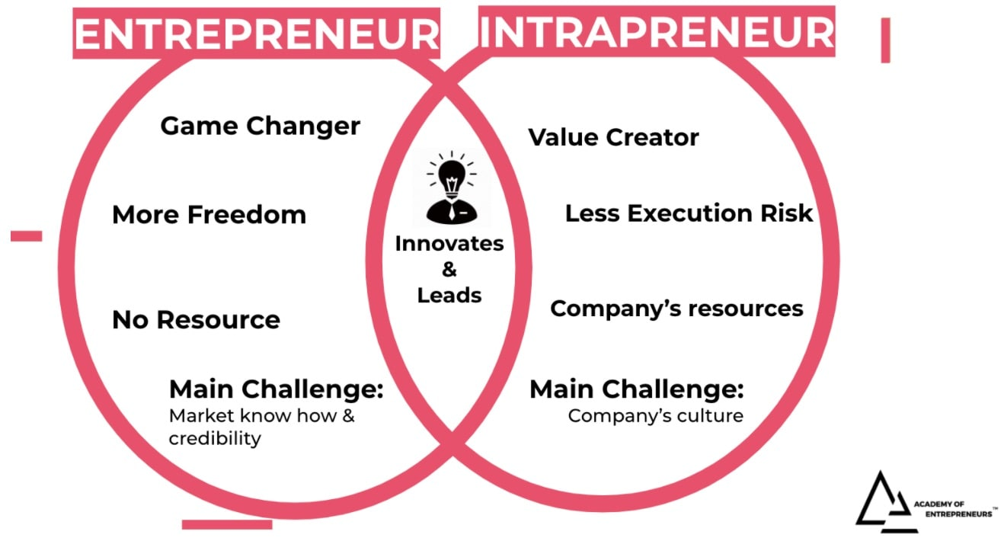
Entrepreneurship vs Intrapreneurship
Entrepreneur refers to a person who set up his own business with a new idea or concept. Intrapreneur refers to an employee of the organization who is in charge of undertaking innovations in product, service, process etc.
Notes:
Qualities in common: creative thinking, problem-solving, resourcefulness and ability to deal with ambiguity; the optimism of being able to recognize and take calculated risks to capture opportunities where others may not; the vision for greatness grounded in the desire to improve the pain points of the everyday; and the inquisitive relentless pursuit to achieve their vision.
They are both engines that make things happen while bringing others with them along the journey, and pushing beyond their comfort zones to grow.

Slide 13
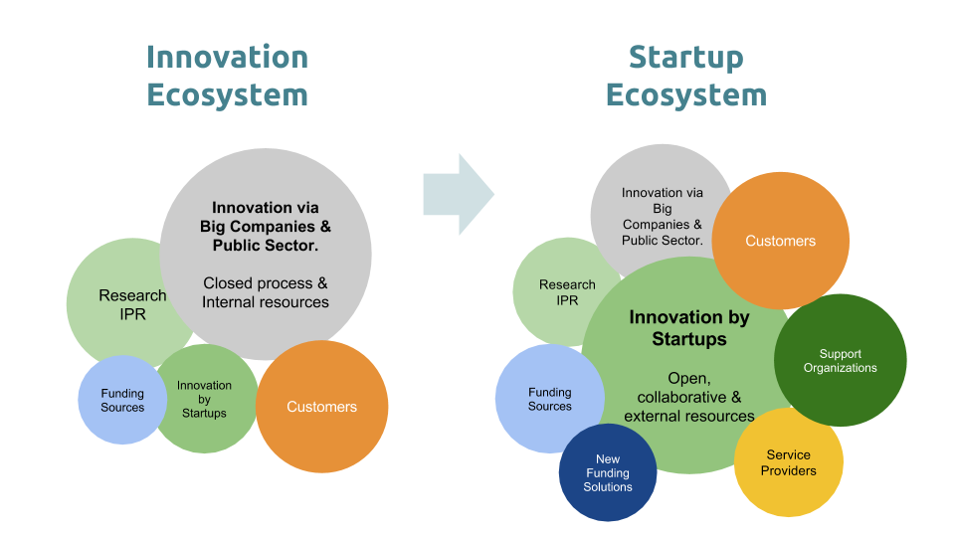
Innovation Ecosystem
An innovation ecosystem refers to a loosely interconnected network of companies and other entities that coevolve capabilities around a shared set of technologies, knowledge, or skills, and work cooperatively and competitively to develop new products and services (Moore, 1993).
Support and funding solutions:
educational programs,
incubators,
hackathons
university hubs,
networking events,
cluster collaboration platforms
Notes:
Emphasis on networking and matchmaking activities at the stage of PhD study.

Slide 14
Thank you
Andrej Takáč Slovak University of Technology in Bratislava

