Slide 1
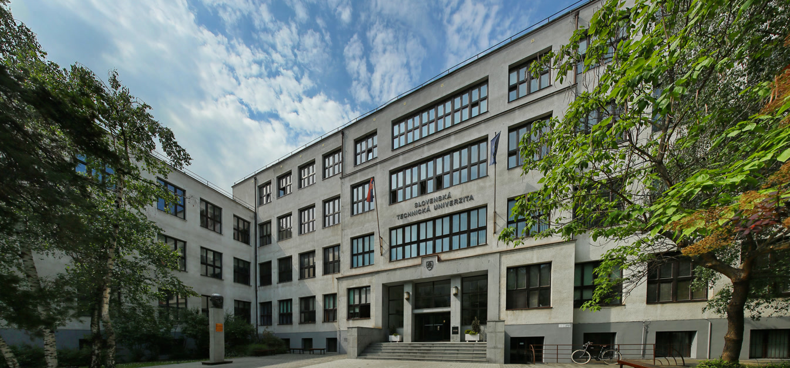
SLOVAK UNIVERSITY OF TECHNOLOGY IN BRATISLAVA
www.stuba.sk

Slide 2
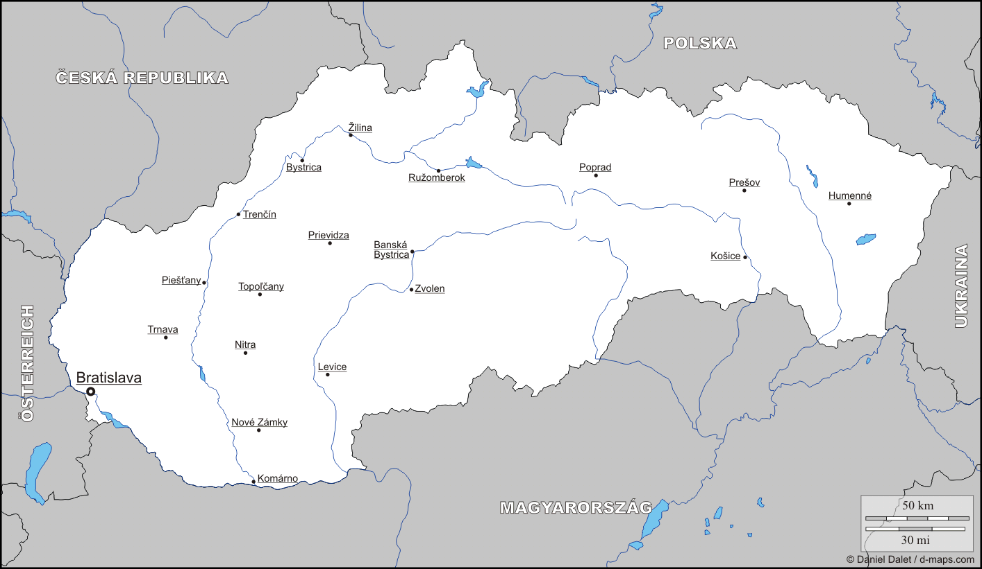
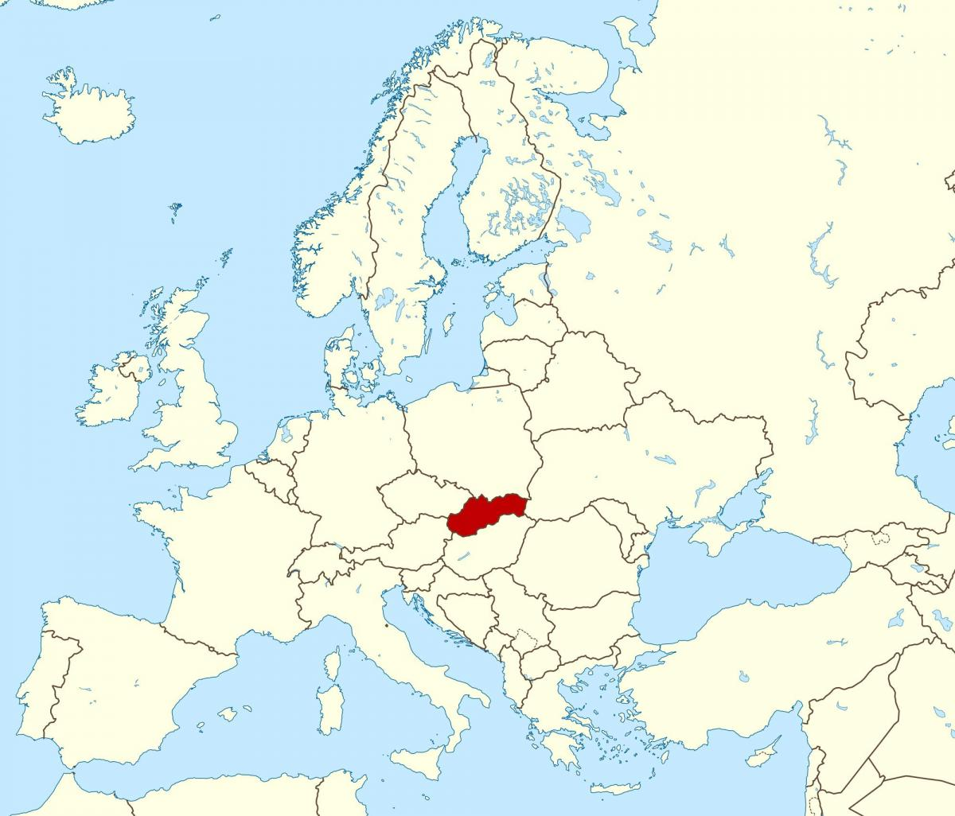
SLOVAKIA

Slide 3
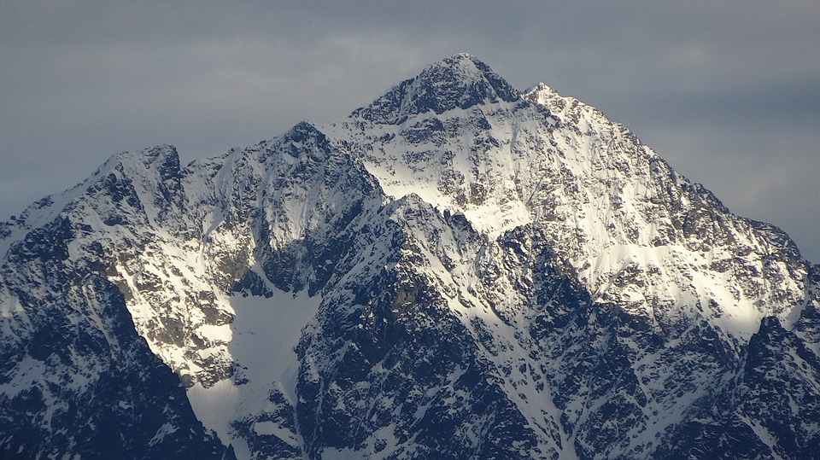
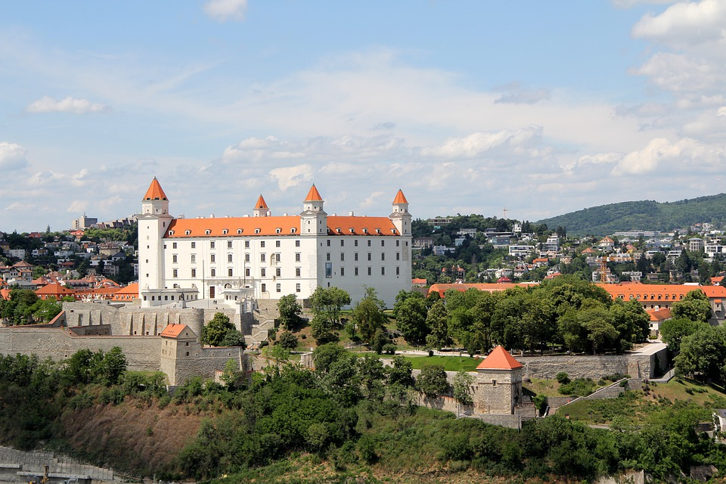
SLOVAKIA - BRIEF OVERVIEW
Coat of arms
of Slovakia
Official name: Slovak Republic
Date of establishment: 1st January 1993
Area: 49,035 km²
Population: 5.4 million
Capital: Bratislava (437 725 inhabitants)
Official language: Slovak
Currency: Euro (1 € = 100 cents)
Time zone: Central European (GMT +1)
Weather: continental climate (4 seasons)
Political system: parliamentary democracy
High Tatras
Bratislava

Slide 4
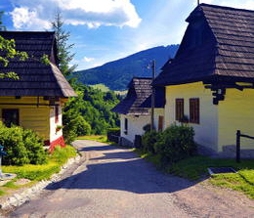
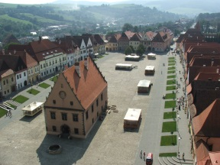
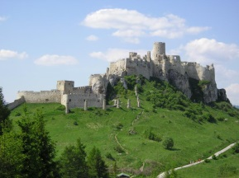
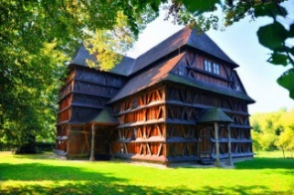
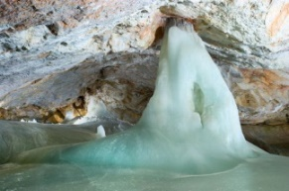
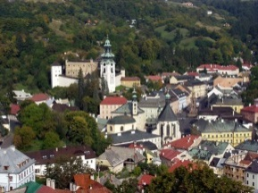
SLOVAKIA - UNESCO NATURAL AND CULTURAL HERITAGE
The village of Vlkolínec, with traditional log houses
The Bardejov town conservation reserve
Spišský hrad (castle) and its associated cultural monuments
Wooden Churches of the Slovak part of the Carpathian Mountain Area
The area of Slovak Karst (Slovenský kras)
Primeval Beech Forests of the Carpathians
The historic town of Banská Štiavnica

Slide 5
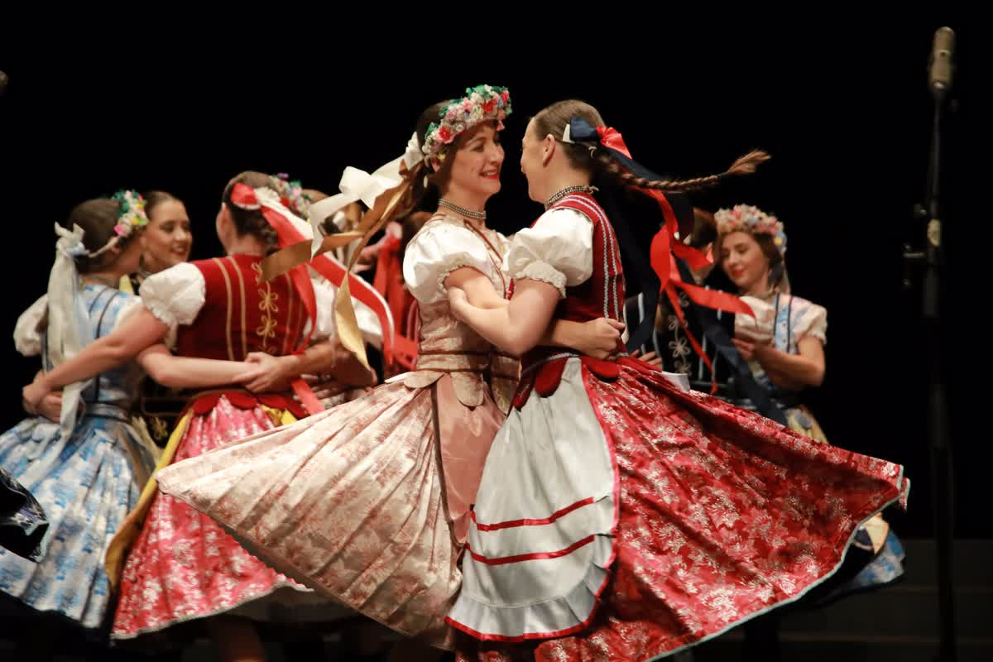
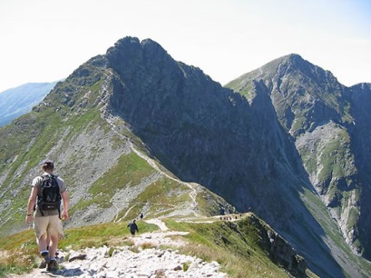
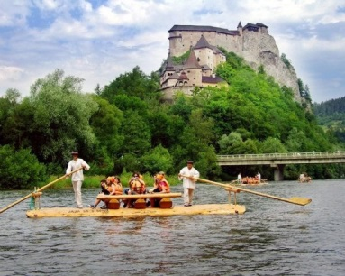
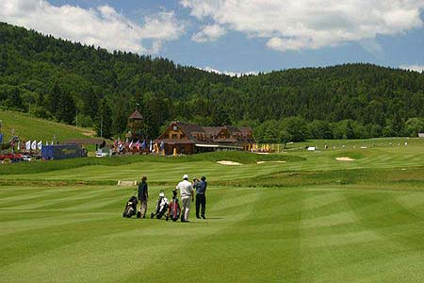
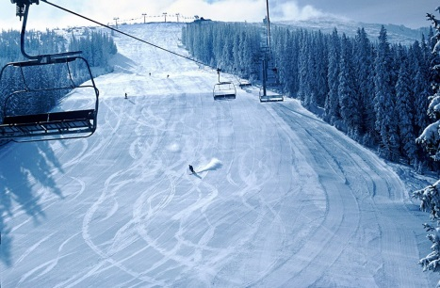
SLOVAKIA - CULTURE AND SPORT
Typical Slovak folklore
The most successful sport:
ice-hockey
Wide range of sport facilities: cycling, hiking, skating, water sports, tennis, golf, skiing, snowboarding.

Slide 6
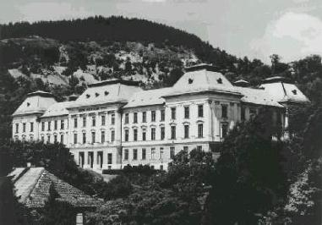
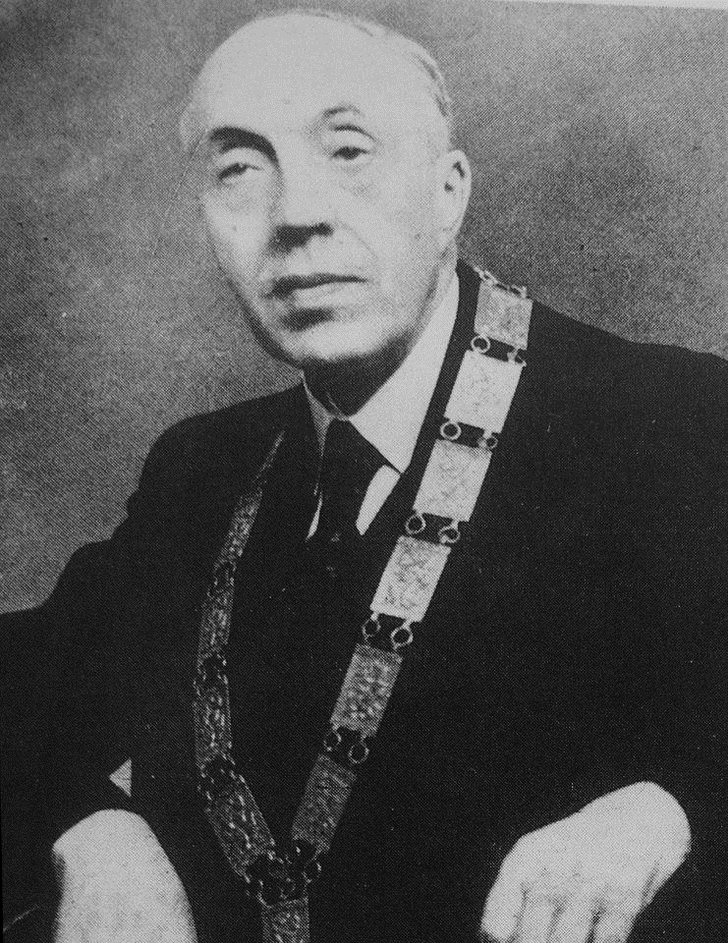
SLOVAK UNIVERSITY OF TECHNOLOGY ORIGIN AND HISTORY
1762 Mining and Forestry Academy under empress of Maria Theresa: first technical higher education institution in the world founded in Banská Štiavnica.
Mining and Forestry Academy
in Banská Štiavnica
1937 University of Technology of M. R. Štefánik: first Slovak technical university was founded in Košice.
1939 Slovak University of Technology, Bratislava:
Branch of Construction Engineering
Branch of Specialized Sciences
Branch of Forestry and Agricultural Engineering
Branch of Chemical Engineering
Branch of Mechanical and Electrical Engineering.
First rector: Prof. Jur Hronec

Slide 7
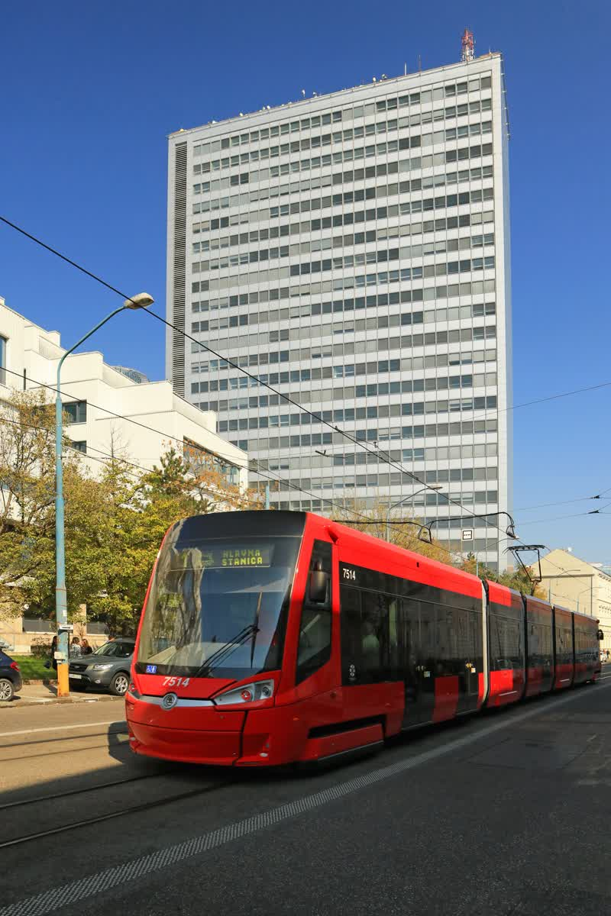
SLOVAK UNIVERSITY OF TECHNOLOGY (STU)
NOWADAYS
STU in numbers:
168 664 graduates
10 976 students
7 faculties (schools)
1 institute
740 research projects
400 study programmes
250 contractual research projects
116 framework agreements with foreign universities
90 international projects
1 280 teaching and research staff

Slide 8
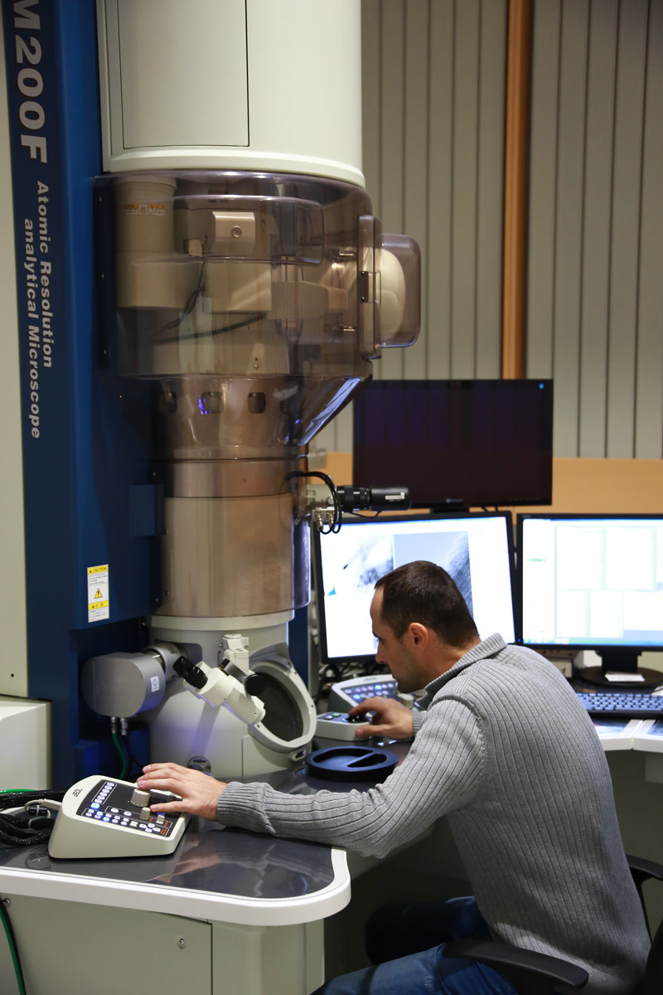
SLOVAK UNIVERSITY OF TECHNOLOGY (STU)
NOWADAYS
STU offers:
unity of education and scientific research, engineering and arts
theoretical-practical learning methods (link to Mining academy in Banská Štiavnica)
direct cooperation with industry & strong international links

Slide 9
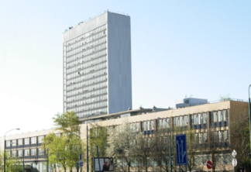
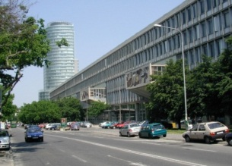
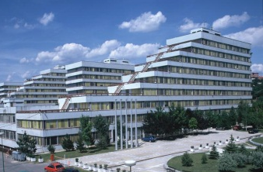
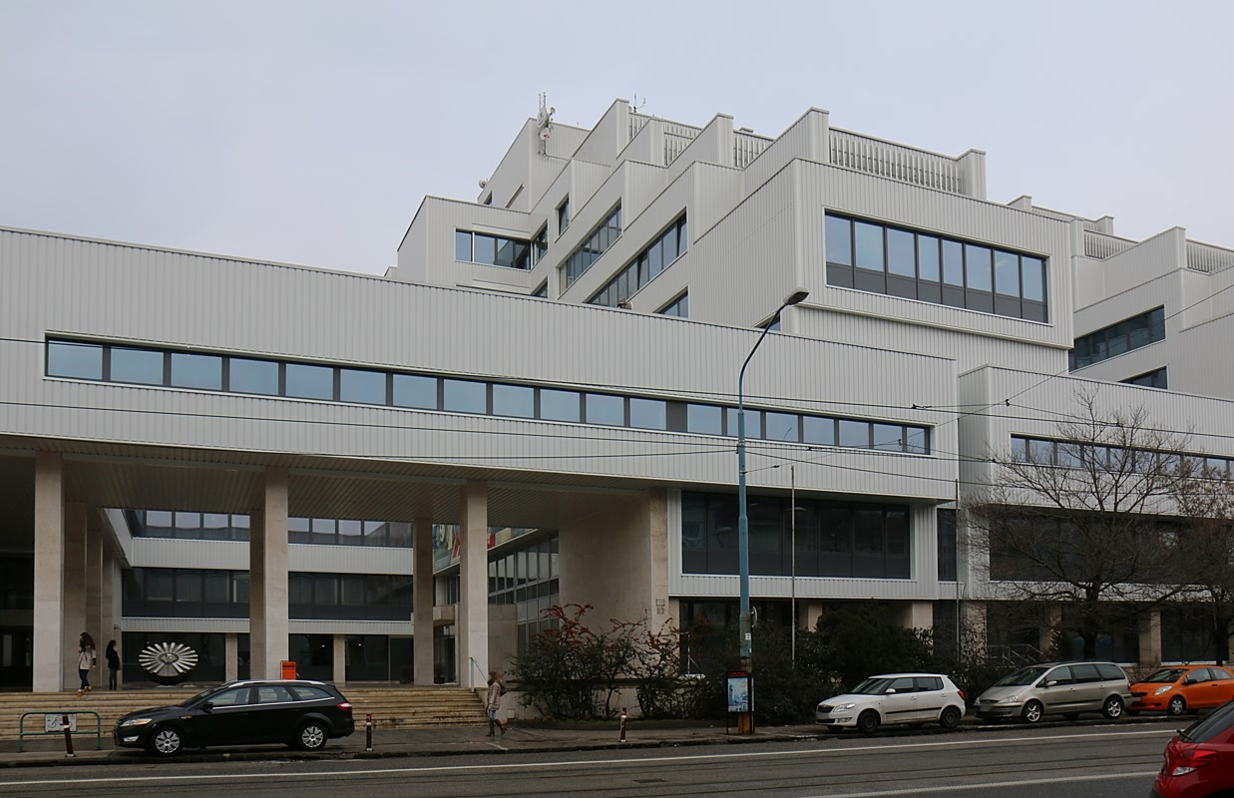
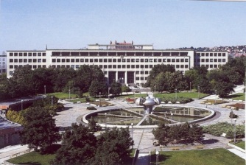
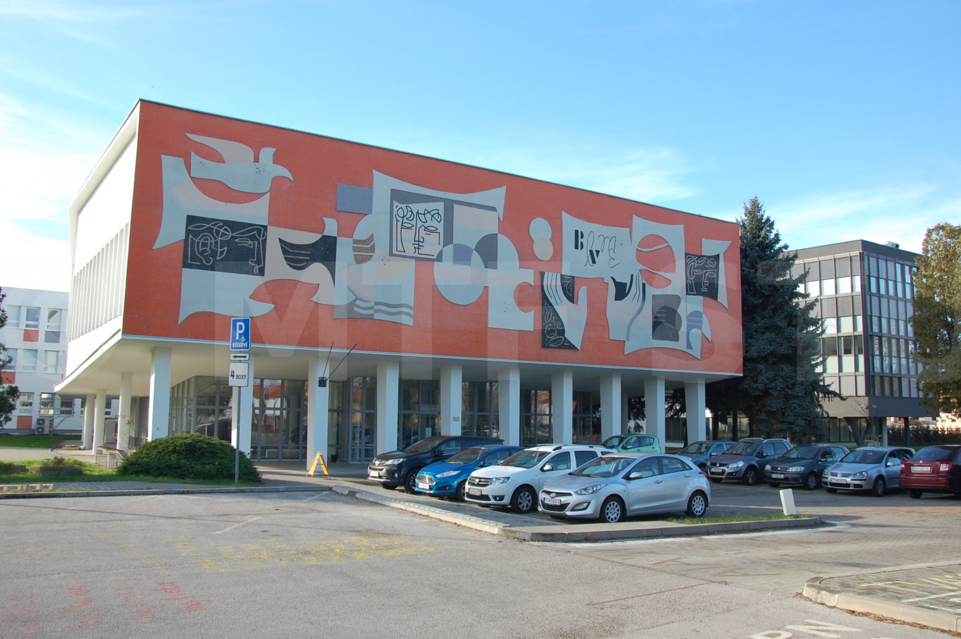
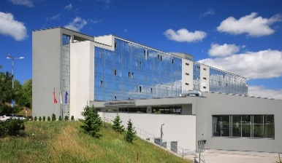
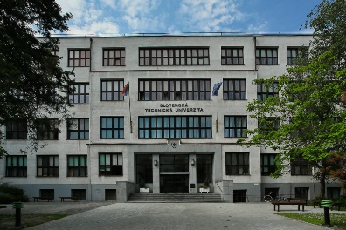
STU - FACULTIES AND UNIVERSITY CENTRES
Faculty of Civil Engineering
Faculty of Mechanical Engineering
Faculty of Electrical Engineering and Information Technology
Faculty of Chemical and Food Technology
Faculty of Architecture and Design
Faculty of Material Sciences and Technology
Faculty of Informatics and Information Technologies
Institute of Management
Lifelong Learning Institute
STU Research Centre
Multimedia centre, Computing Centre, Publishing House,
Student Houses, Academic Sports Centre

Slide 10
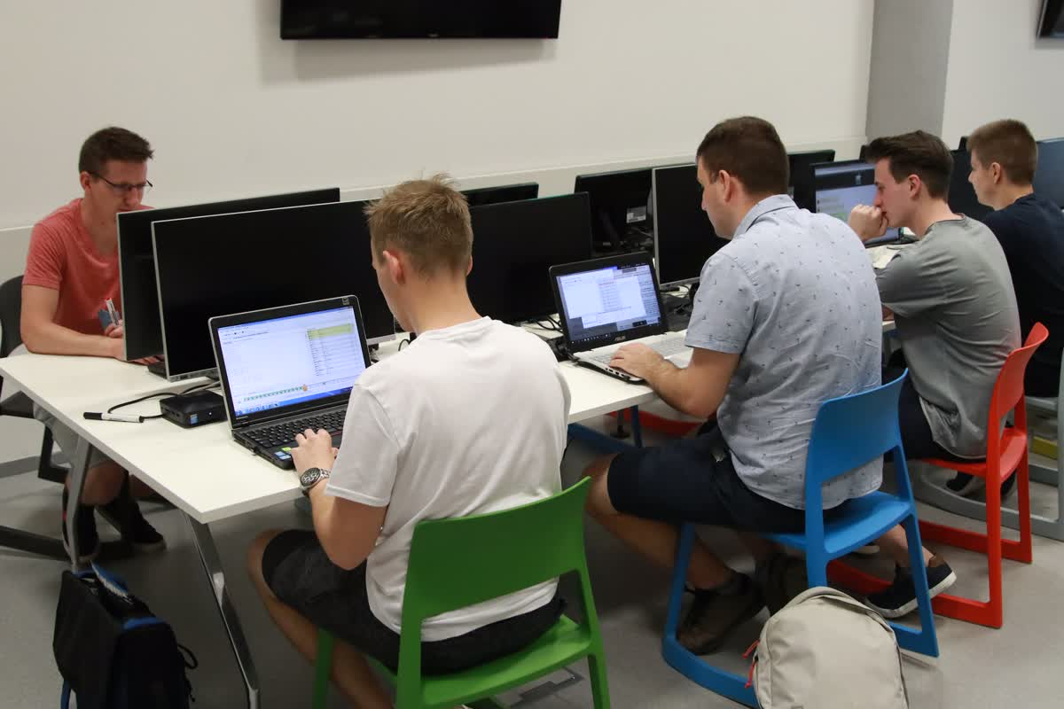
STU STUDY SYSTEM
Harmonized with Bologna Declaration and European Credit Transfer System (ECTS)
Students engaged in research (mainly at Master and PhD. level)
Modern training methods, laboratories, project works
Study programs in English
Lifelong learning
3rd DEGREE
3 or 4 years
2nd DEGREE
2 or 3 years
Doctoral study
131 study programs
767 students
1st DEGREE
3 or 4 years
Master study
64 study programs
3 285 students
Bachelor study
61 study programs
6 924 students
10

Slide 11
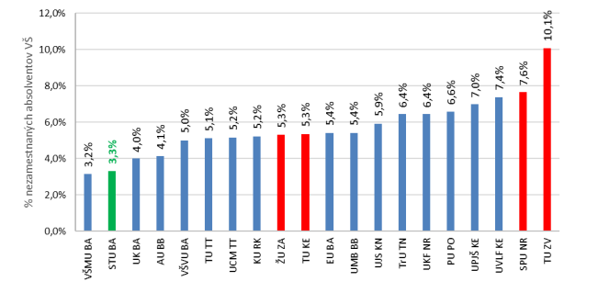
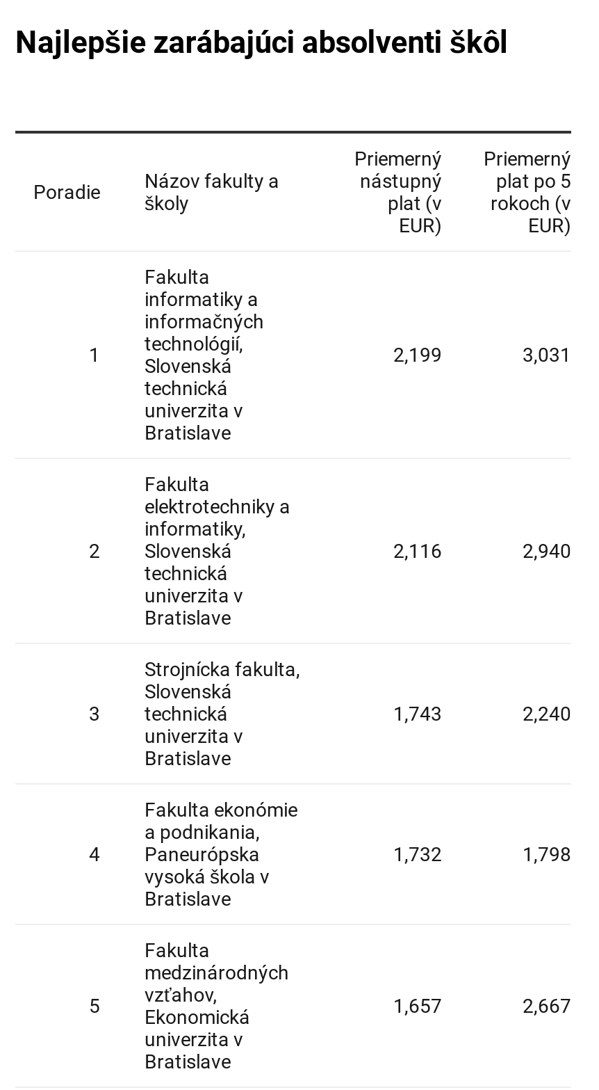
QUALITY OF GRADUATES
Public HEIs
Public HEIs
The second lowest unemployment % of STU graduates among other HEIs in Slovakia (2019).
The highest salary average of STU - graduates among other HEIs in Slovakia (2019).

Slide 12
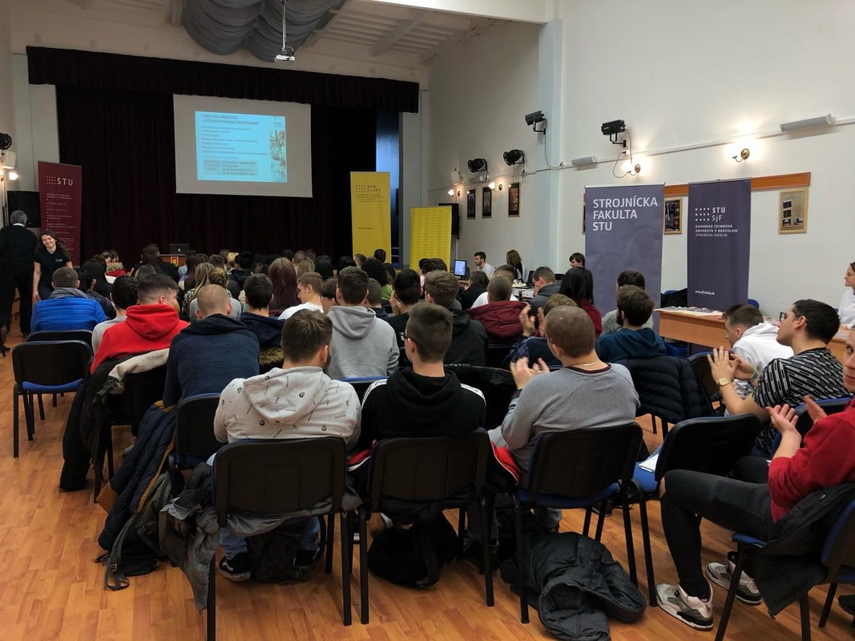
INSTITUTE OF LIFELONG LEARNING AT STU
Continuing Education Centre: variety of courses and retrainings.
Professional MBA Automotive Industry: 2-years distance accredited study for professionals from automotive industry.
Department of Technical Pedagogy: Qualification for teaching in technical subjects (2-years additional study for students).
Third Age University: support to the elderly and risk groups.
Study of foreign languages

Slide 13
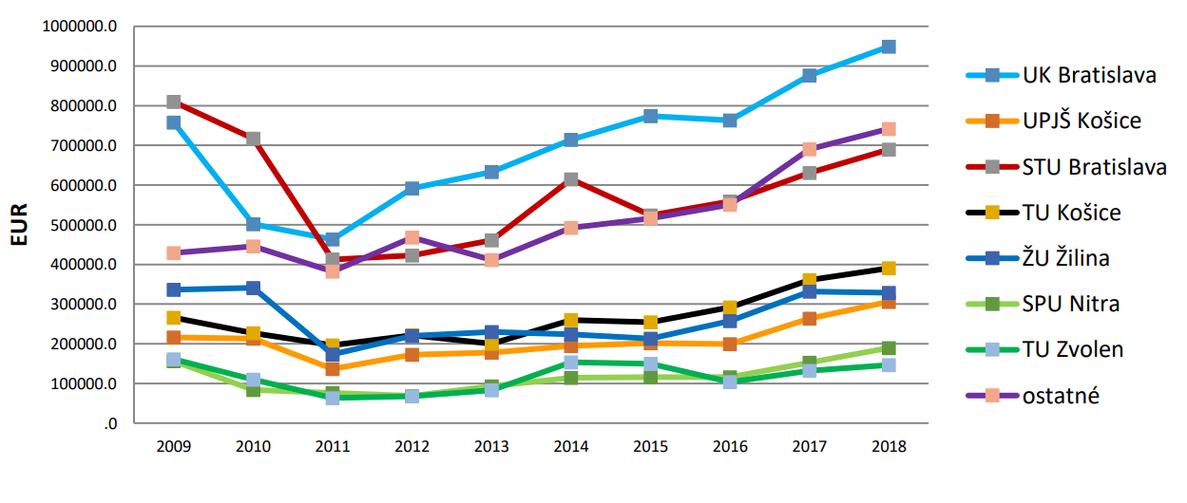
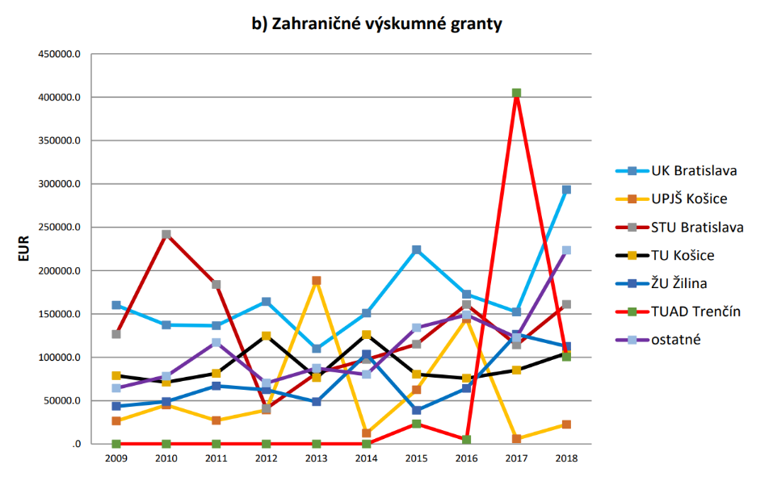
RESEARCH AT STU TODAY
Domestic research grants
Foreign research grants
Centres of Excellence
SMART – technologies, systems and services
FLOOD PROTECTION systems
URBAN INFRASTRUCTURE
ENERGY - renewable energy sources
5-AXIS MACHINING
MATERIAL ANALYSIS (metal and non-metal)
INDUSTRIAL BIOTECHNOLOGY
Funds obtained by STU in 2019 from domestic grant agencies:
7 844 821 EUR
Funds obtained by STU in 2019 from foreign grant agencies:
2 188 248 EUR

Slide 14
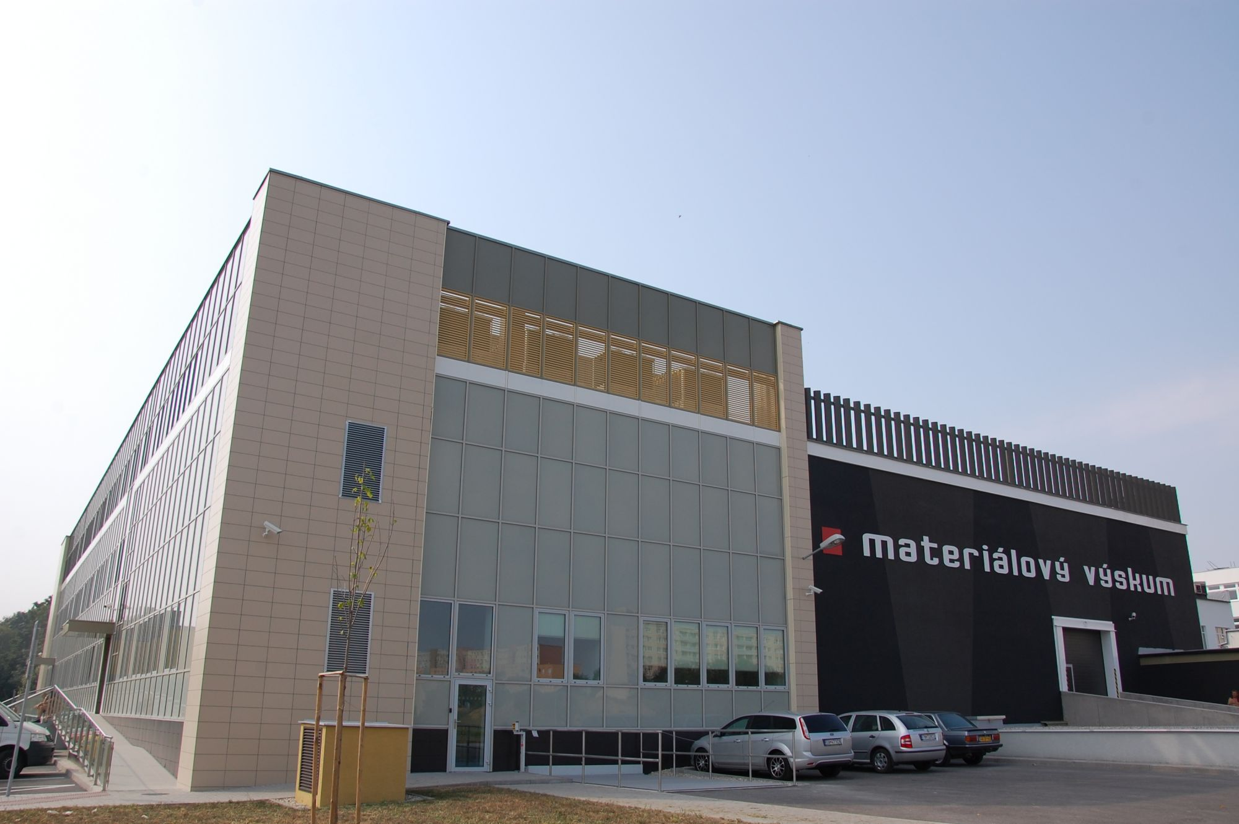
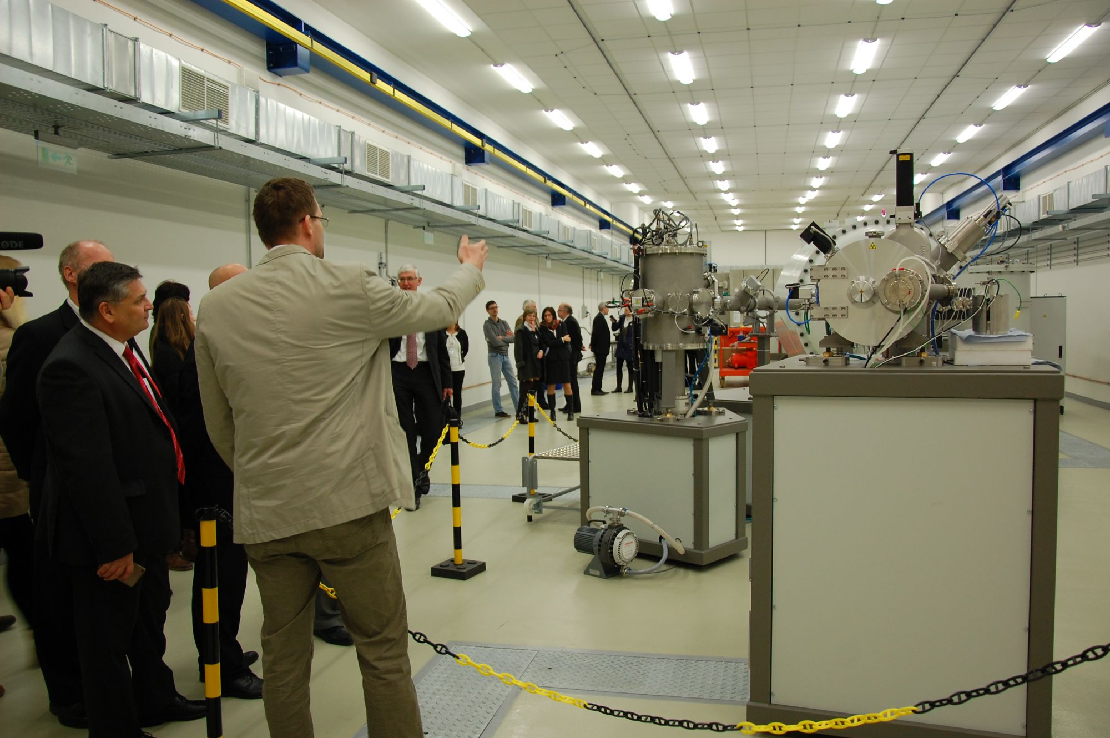
FUTURE OF RESEARCH AT STU
„University research park STU“: Project financed by EU structural Funds (Operational Program of Research and Development) in the value of 80 mil. €.
University research park in Bratislava focused on information and communication technologies, electrical engineering, automation and control systems, nanoelectronics and photonics.
University research park in Trnava focused on material engineering, ion and plasma technology, automation and computerization of industrial processes.
University research park in Trnava

Slide 15
INTERNATIONAL COOPERATION
INTERNATIONAL AGREEMENTS IN 2019
University Agreements: 115
Faculty agreements: 41
Erasmus agreements: 268
INTERNATIONAL PROJECTS IN 2019
CEEPUS
ERASMUS+
TEMPUS
Total: 78 projects
MOBILITIES
Erasmus
CEEPUS, IAESTE, BEST
National Scholarship program
MEMBERSHIPS
European Universities Association
European Society for Engineering Association
others (21 institutional memberships > 500 individual).

Slide 16
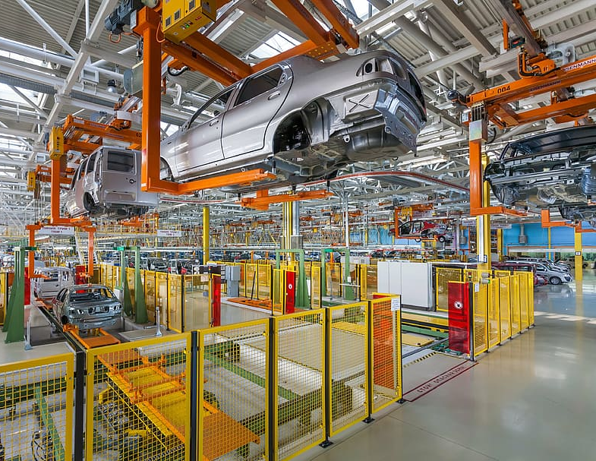
INDUSTRIAL COOPERATION
800 Industrial contracts
Diploma Thesis and trainings for students
Collaborating projects
Mobility and industrial placements in European research area
Entrepreneurship support for start-up, spin-off
Volkswagen, PSE, Siemens, Atos, ABB Bratislava, Samsung, IBM, HP, ESET, Applied Precision, Danubia Nanotech, Nanodesign, Slovenské elektrárne, ZSE Distribúcia, SEPS, Evonik Fermas, Bioenergy, Dopravoprojekt, Slovenský vodohospodársky podnik, Národná diaľničná spoločnosť, SPP...

Slide 17
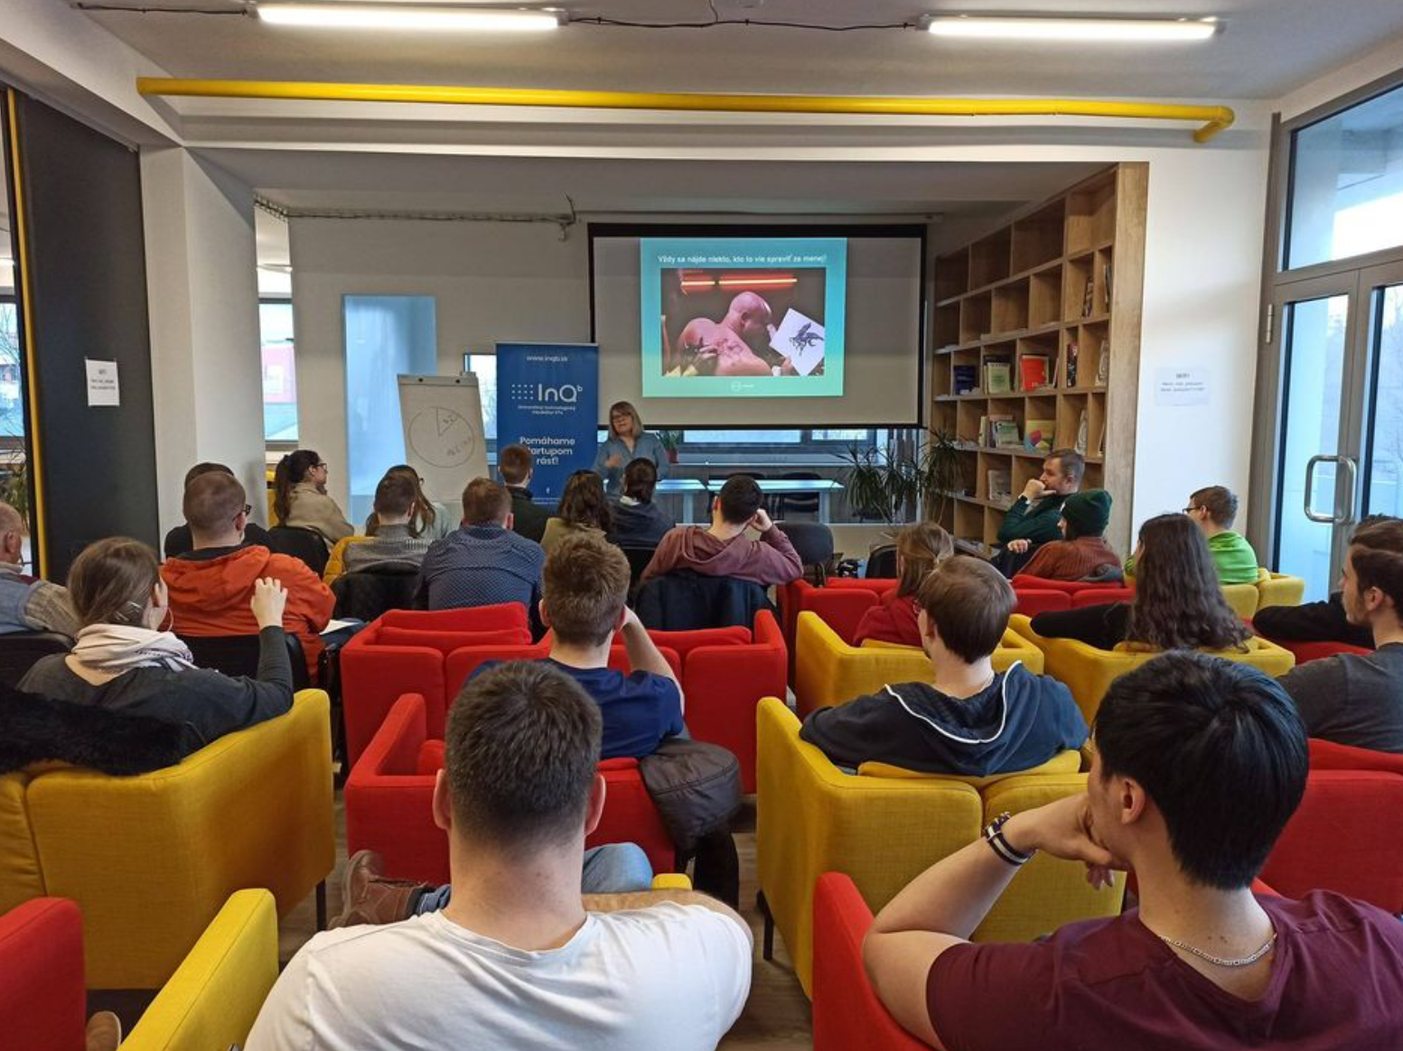
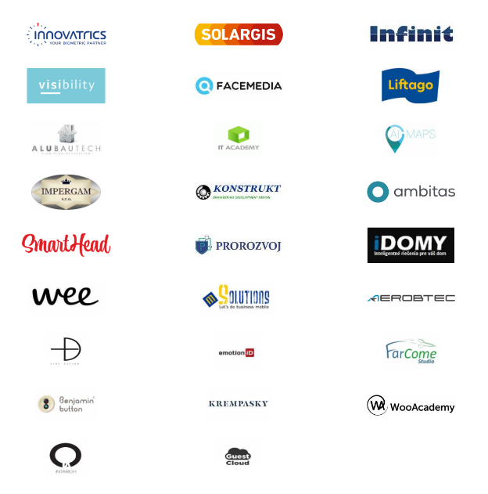
UNIVERSITY TECHNOLOGY INCUBATOR
Start-up Office and InQb program
The Start-up Office program is designed mainly for students and graduates, who plan to establish their own innovative business with focus on production in the area of technology. For 3 months, they can use an equipped office, as well as consulting in the area of setting up a business and drafting a business plan.
The InQb Program is designed for those who are either planning to, or have already established their own innovative business focused on production in the area of technology.
www.inqb.sk

Slide 18
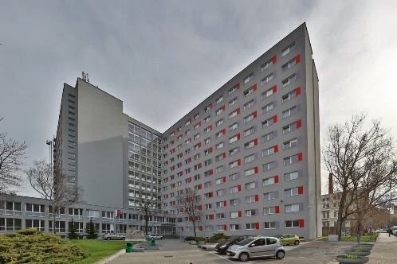
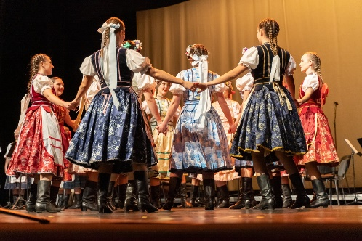
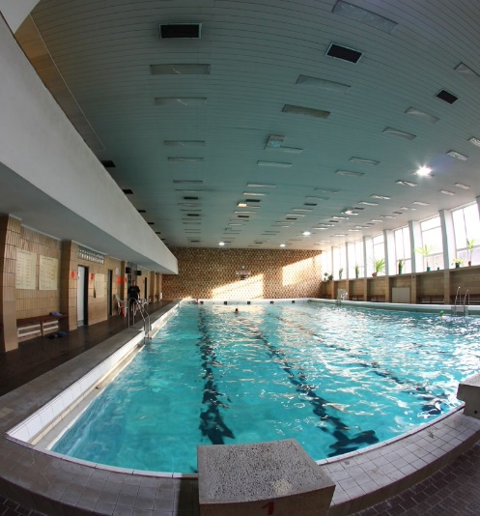
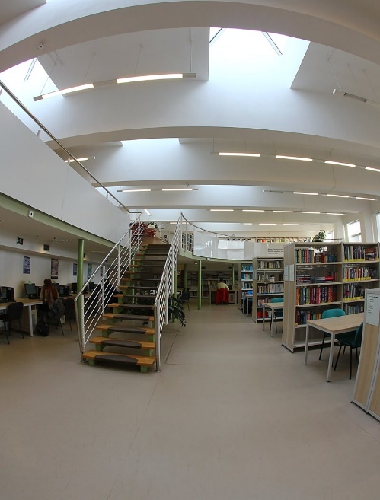
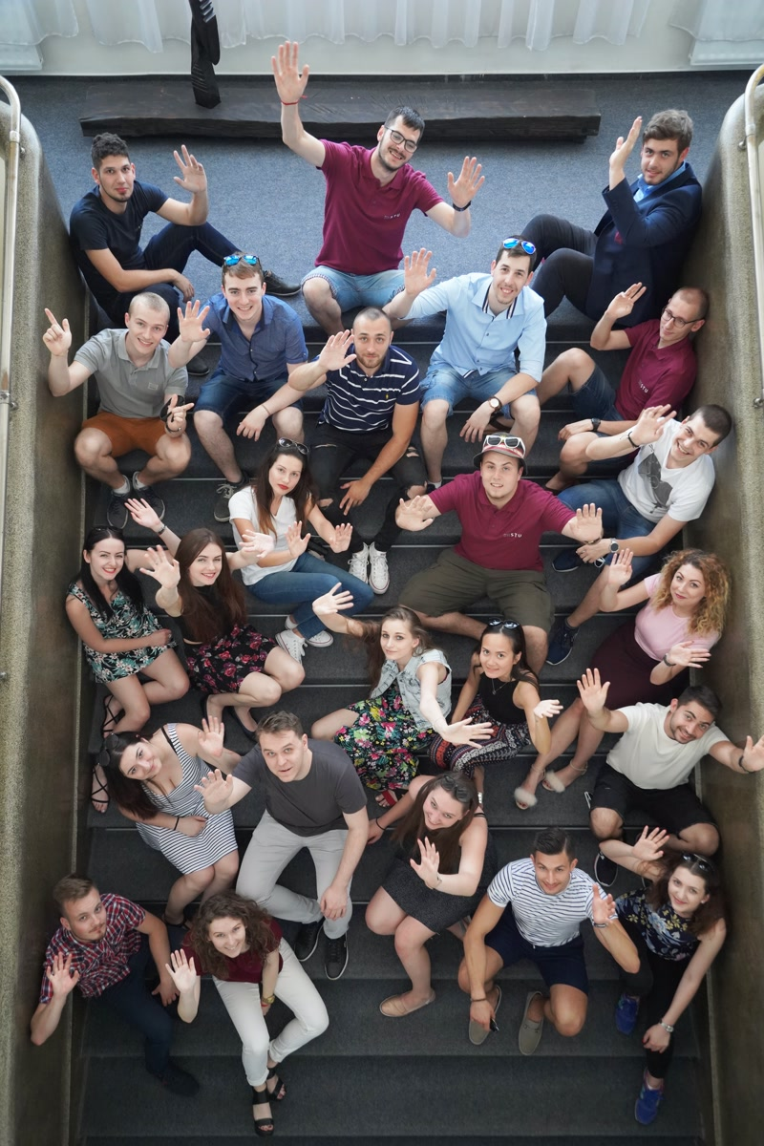
SERVICES FOR STUDENTS
7 libraries, on-line access to databases
Free Internet
8 student houses
Canteens and buffets
Health care services
Sport facilities
University Ensemble „Technik“

Slide 19
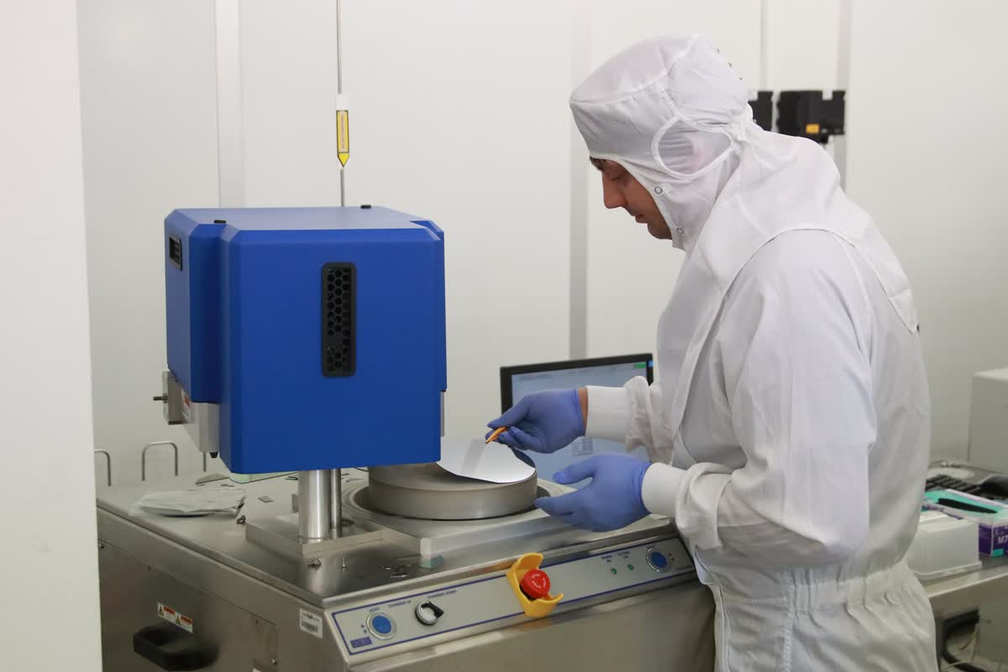
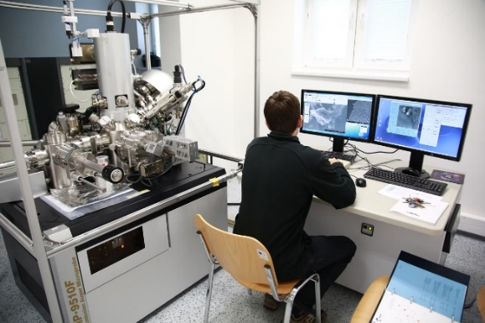
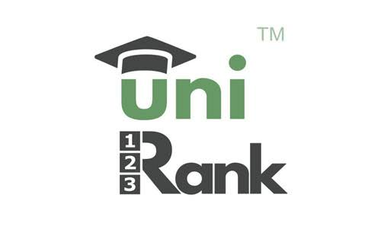
STU – RANKINGS AND AWARDS
position 751 - 800 in 2020
position 801 - 900 in 2020
2nd best slovak University

Slide 20
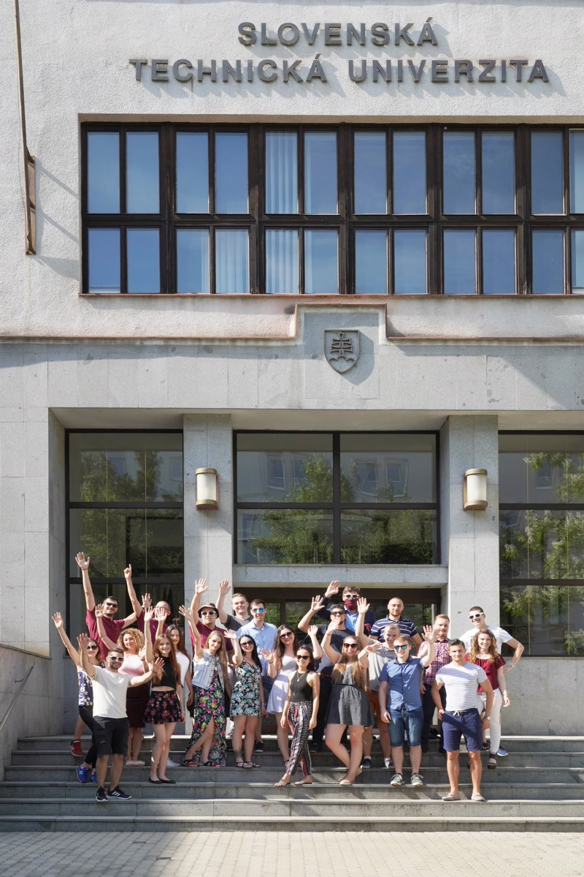
SLOVAK UNIVERSITY OF TECHNOLOGY IN BRATISLAVA Vazovova 5
812 43 Bratislava 1 Slovakia www.stuba.sk

